Slide 1
Journal club
แพทย์ประจำบ้านปี2 กิตติพิชญ์ อุลิศ
อาจารย์ที่ปรึกษา พ.ต.ณัฐธพงษ์ ภูวโชติโรจนโภคิน

Slide 2
Anesthesia & Analgesia • October 2015 • Volume 121 • Number 4

Slide 3
Background
Multiple passes and attempts while administering spinal anesthesia
PDPH
Paresthesia
Spinal hematoma

Slide 4
Ultrasound guided spinal anesthesia
Real-time and preprocedural neuraxial ultrasound techniques
improve the success rate
increase the first-pass success rate in difficult surface anatomic landmarks

Slide 5
Ultrasound guided spinal anesthesia
limited by
Require wide-bore needles
the technical difficulties
Previous studies focused on
a midline approach using a transverse median (TM) view.

Slide 6
Ultrasound guided spinal anesthesia
The parasagittal oblique (PSO) view
offers a better ultrasound view compared with TM views
No studies
Superior PSO views translate into easier paramedian needle insertion.

Slide 7
Background
Hypothesized that
Preprocedural the ultrasound-guided paramedian spinal technique results in fewer passes required to enter the subarachnoid space when compared with the conventional landmark-based midline approach.

Slide 8
Methods

Slide 9
Methods
Study design
Prospective, randomized, controlled study
Inclusion
100 patients
Undergo elective total knee or total hip arthroplasty
Plan for spinal anesthesia

Slide 10
Methods
Exclusion
contraindications to spinal anesthesia
Allergy to local anesthetic
Coagulopathy
local infection
Indeterminate neurological disease

Slide 11
Methods
Randomized
Using random numbergenerating software (Research Randomizer version 4.0)
Conventional landmark-guided spinal anesthesia (group C)
Preprocedural ultrasound-guided paramedian spinal anesthesia (group P)
concealed by enclosing the codes in a sealed opaque envelope

Slide 12
Methods
In both groups
Spinal anesthesia was performed by 1 of 3 consultant anesthesiologists
Each anesthesiologist having performed >75 neuraxial ultrasound scans before the study.

Slide 13
Methods
On arrival to operating room
Baseline monitoring (noninvasive blood pressure, pulse oximetry, and 3-lead electrocardiography)
IV access.
Patients sit on a level trolley with feet resting and given a pillow to hug
No sedation was given

Slide 14
Methods
In group C
Anesthesiologist palpated the landmarks
Graded the ease of palpation on a 4-point scale (easy, moderate, difficult, or impossible)
Strict asepsis was observed
The skin was prepared with 2% chlorhexidine after 2 to 5 mL of 1 % lidocaine infiltrated the skin.

Slide 15
Methods
Allowed to
Choose the appropriate needle length (90- or 119-mm 25-G Whitacre needle), gauge (25-G or 22-G), depth, and angle of insertion
The type and dose of local anesthetic
After completion of spinal anesthetic injection
Ultrasound identified the interspinous level which was injected

Slide 16
Methods
In group P
Portable ultrasound unit (SonixTablet, Peabody, MA) with a curved 2- to 5-MHz probe was used
A paramedian sagittal oblique view was obtained
The sacrum was identified
Interlaminar space between L5 and S1 was noted

Slide 17
Methods
Selected the interspinous space at which the clearest image
anterior complex (ligamentum flavum dura complex [LFD])
posterior complex (posterior longitudinal ligament [PLL])

Slide 18
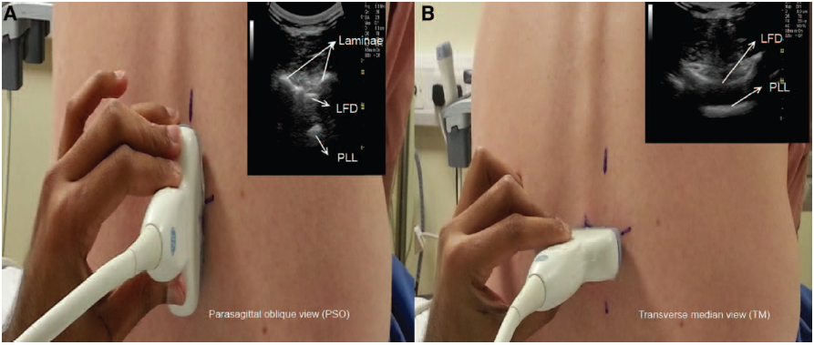

Slide 19
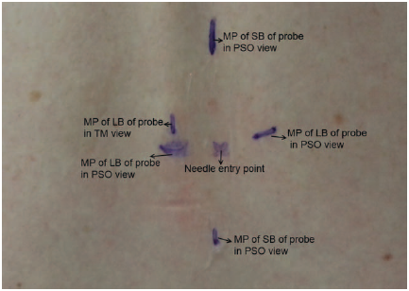

Slide 20
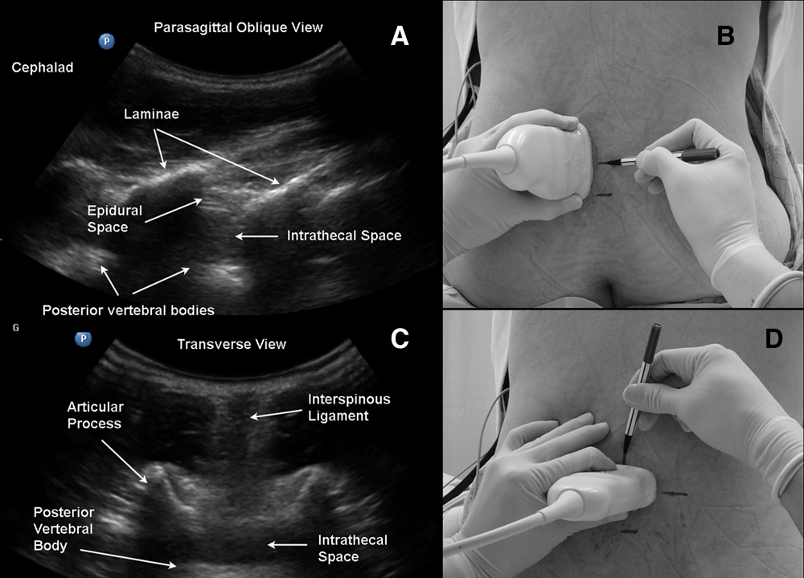

Slide 21
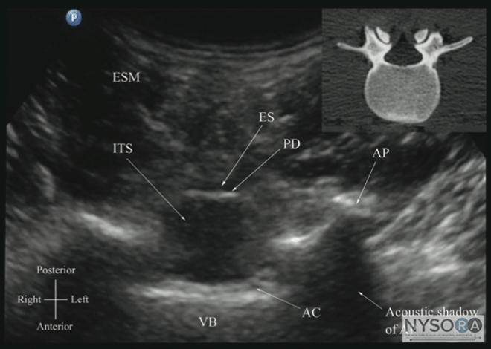

Slide 22
Methods
Both PSO and TM views were graded
Good (both LFD and PLL visible)
Intermediate (either LFD or PLL visible)
Poor (both LFD and PLL not visible).
In group P
Anesthesiologist did not palpate the landmarks for grading until the spinal injection was complete.

Slide 23
Methods
In both groups
Alternative methods could be used if 3 attempts were unsuccessful.

Slide 24
Methods
The outcomes
Noted by a single observer for all patients.
The observer could not be blinded
A timer was used to record the various time intervals
Radicular pain, paraesthesia, or blood in the spinal needle
noted and followed over the next 24 hours

Slide 25
Methods
Patients were asked for their periprocedural pain scores
After positioning
Before administration of sedation
Level of block
Loss of cold sensation tested with ethyl chloride spray
Noted 15 minutes after injection.

Slide 26
Study outcomes
The primary outcome
The difference in number of passes between the 2 groups
Secondary outcomes
1. Number of spinal needle insertion attempts
2. Time for identifying landmarks
3. Time taken for performing spinal anesthetic
4. Level of block
5. Incidence of radicular pain, paraesthesia, and blood in the spinal needle
6. Periprocedural pain
7. Periprocedural discomfort score

Slide 27
Statistical analysis
Based on a previous study
the average number of passes would be 3.3 +/-3.1 (mean +/- SD).
We hypothesized that
Using a preprocedural paramedian spinal, the number of passes could be reduced to 1.3
A total of 38 patients in each group would have been needed to achieve a power of 0.8 and type 1 error of <0.05.

Slide 28
Statistical analysis
Normal distribution data were analyzed using the Shapiro-Wilk test.
Categorical data were analyzed using the χ2 test or Fisher exact test as appropriate.
Normally distributed parametric data were analyzed using Student t test.
All tests were 2-tailed.

Slide 29
Statistical analysis
For non-normally distributed count data zero truncated negative binomial regression was used
For other variables that were nonnormally distributed, especially if the data could not be approximated by log-normal distribution, a bootstrap independent samples test was applied

Slide 30
Statistical analysis
For patient characteristic and primary outcome variables
A 2-tailed P < 0.05 was considered significant and 95% CIs were reported.
For all other outcome variables
a 2-tailed P value <0.01 was considered statistically significant and 99% CIs were reported.
SPSS (IBM SPSS Statistics for Windows, Version 21.0, Armonk, NY) and STATA 12.1 (StataCorp LP, College Station, TX) were used for statistical analysis.

Slide 31
Results

Slide 32
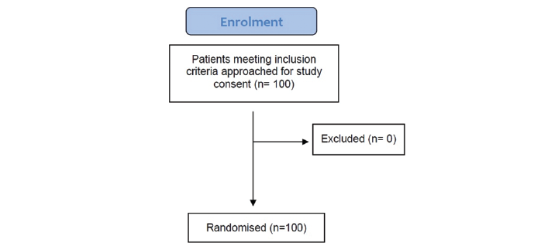
Results

Slide 33
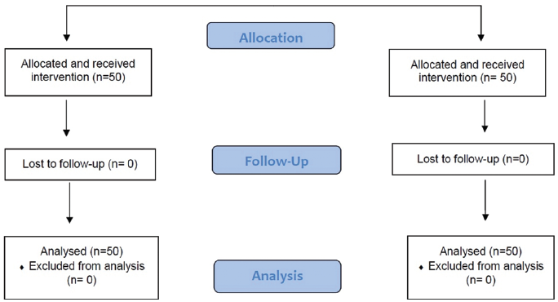

Slide 34
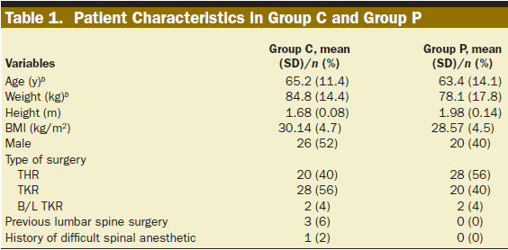
Characteristics
Similar between the 2 groups

Slide 35
Outcomes
Statistically significant

Slide 36
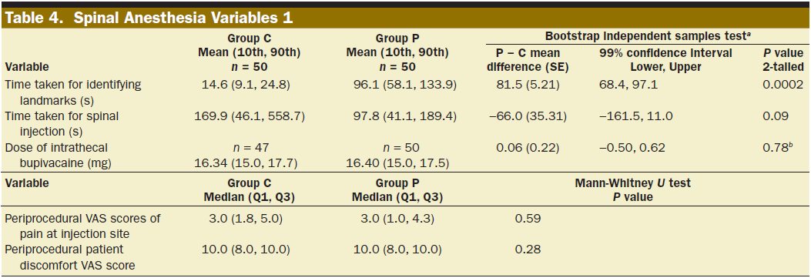
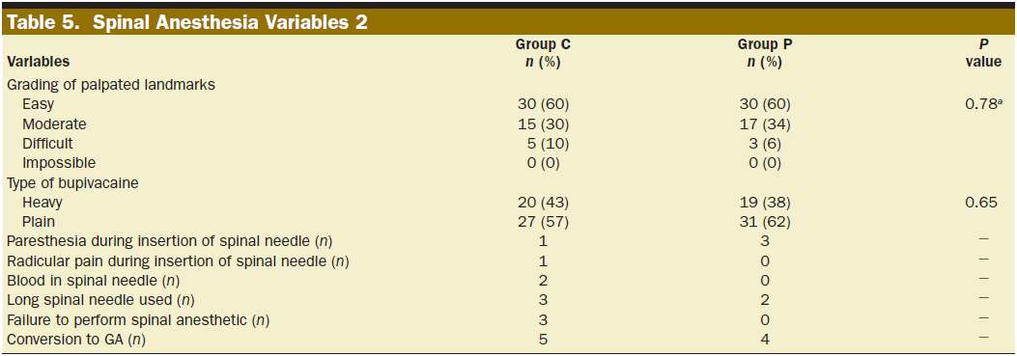

Slide 38
Results
Alternative techniques used
6 patients in group C (ultrasound-guided paramedian spinal)
2 patients in group P (midline approach by conventional palpation).
No significant difference between the 2 groups in requirement for alternative techniques (Fisher exact test, P = 0.27).
Radicular pain or paraesthesia during needle placement
5 patients in the study
none of them had persistent symptoms.

Slide 39
Disscussion
The use of a preprocedural ultrasound-guided paramedian spinal technique resulted in
>50% reduction in the number of passes required for success
Significantly reduced the number of attempts and increased the first attempt success rate

Slide 40
Disscussion
The number of passes was greater in our control group compared with the referenced study
First, the patient population was different. Mean age 65.2 years and body mass index 30 kg/m2, versus 56.2 years and 23.8 kg/m2 in the referenced study.
Second, in the study by Kim et al., the number of passes was self-reported, VS recorded by an independent observer

Slide 41
Disscussion
The routine use of preprocedure ultrasound in the general adult or obstetric populations has not been shown to improve the number of passes or attempts

Slide 42
Disscussion
For this study, a reduction in number of passes because
The patient population was older
More difficult in TM approach on an older patient: interspinous ligament calcification, inadequate flexion and narrow interspinous space
Used both the probe angle and the midline marking to aid paramedian insertion

Slide 43
Disscussion
Previous studies that showed
no difference on first-pass success rates between the 2 groups (success at first attempt and first pass)
This study
Look specifically at the number of passes
Using only first-pass success rates may risk overlooking important between-group differences.

Slide 44
Disscussion
In group P,
Establishing landmarks took on average 81.5 seconds longer (99% CI, 68.4–97.1)
marked only one interspinous space, to reflect real-time practice
In a study by Chin et al.,
The ultrasound group took 240 seconds longer.
Scanning in patients with difficult surface landmarks
Marking 3 interspinous spaces.

Slide 45
Limitatations
First, neither the observer nor the attending anesthesiologists were blinded to the study group.
bias cannot be excluded

Slide 46
Limitatations
Second, the procedure is heterogeneous with multiple factors affecting the number of passes, including
Individual preference and style
The number of attempts and/or time taken before using alternate methods

Slide 47
Limitatations
Third, neuraxial ultrasound has limitations.
TM views for a midline approach to dural puncture have a positive predictive value of up to 85% but a negative predictive value of just 30%
Ultrasound views are more difficult in the elderly
The necessity to remember the angle of approach
Decrease the utility of ultrasound views in patients with a longer distance between skin and dura mater.

Slide 48
Conclusion

Slide 49
Conclusion
The use of paramedian spinal anesthesia in an elderly orthopedic population, guided by preprocedure ultrasound examination, significantly decreases the number of passes and attempts needed to reach the subarachnoid space

Slide 50
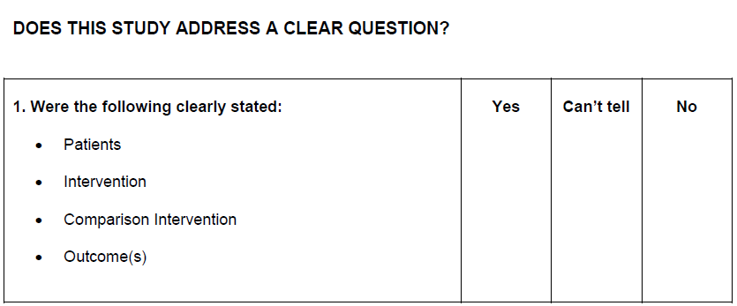
Critical appraisal

Slide 51
Critical appraisal

Slide 52
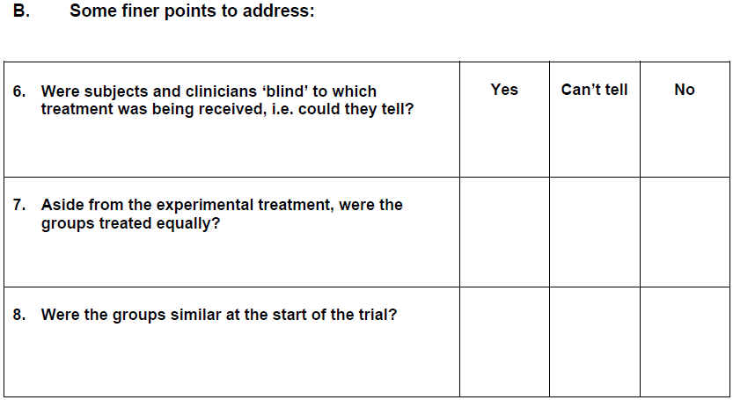
Critical appraisal

Slide 53
Critical appraisal

Slide 54
Critical appraisal

Slide 55
Thank you

